Slide 1

C Programming
04: Conditional Statements & selection structure

Slide 2
Recap
Last week
Variables
Expressions--statement
This week
Branching & looping statements

Slide 3
Grade Values
A professor generates letter grades using the following table.
Goal: given the scores, to print the grade for each student.
int main()
{ ...
printf(“F\n”);
printf(“D\n”);
printf(“C\n”);
printf(“B\n”);
printf(“A\n”);
}
Score | Grade
0-60 | F
61-70 | D
71-80 | C
81-90 | B
91-100 | A
?

Slide 4
selection structure
Previous code
T
p
F
A
B
Conditional statement
Next code to run

Slide 5
Conditional Statements
Conditional statements allow us to decide
Do we take the bus to class?
Or do we walk?
And to execute different statements
Put bus pass in pocket
Put walking shoes on

Slide 6
Conditions
A condition is either false or true
In C, an integer
False = 0
True = anything else
So any expression can be used
if it returns an integer or boolean value

Slide 7
Boolean Value
C programming language assumes any non-zero and non-null values as true, and if it is either zero or null, then it is assumed as false value

Slide 8
Conditional Operators
We have to be true OR false
Relational Operators
 | True (1) | False (0)
A ==B | A, B are equal | A, B are not equal
A != B | A, B are not equal | A, B are equal
A < B | A is less than B | A is > or = B
A <= B | A is < or = B | A is greater than B
A > B | A is greater than B | A is < or = B
A >= B | A is > or = B | A is less than B

Slide 9
Logical Operators
Once you have logical values
You can start combining them
There are three notations for it:
&& (and), || (or), ! (not)

Slide 10
Logical &&, ||, !
If you have more than one, use ()
A && B | True if both A and B are true
A || B | True if either A or B is true (or both)
! A | Unary not - true if A is false
int ReadToGo=
((month == may) && (year == 2018)
&& (havePassedEverything));

Slide 11
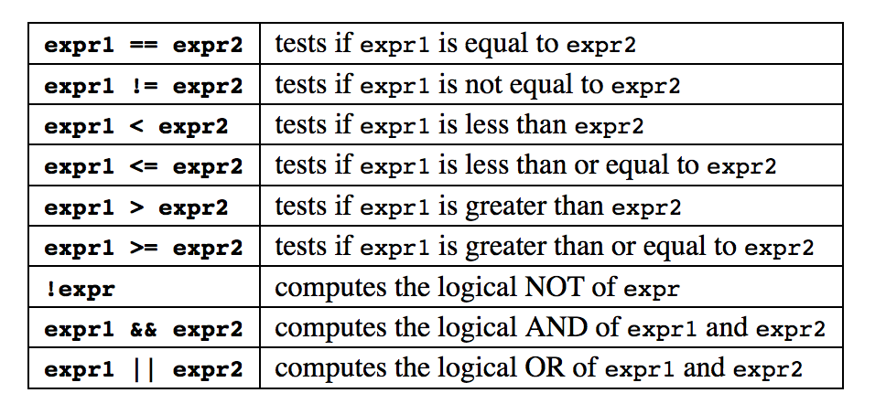
Conditional Expressions

Slide 12
Operator Priority
Relational Operators
> | <
>= | <=
== | !=
! |  | high
Arithmetic operator
关系运算符
Relation operator
&& ||
Assignment operator |  | low
Logical Operators
&& | || | ！

Slide 13
Selection structure
1
2
Single-alternative selection structure
Dual-alternative selection structure

Slide 14
Single-alternative selection structure
The single-alternative selection structure evaluates a condition and executes a block of code if that condition is true. If the condition is false, then the block of code is ignored.
T
F
T
expression
F
statement1
An example of a single-alternative selection structure is the if statement.

Slide 15
Single-alternative selection structure
If Statement
Tests whether a condition is true
Then executes a statement if it is true
Does nothing if it is false
Syntax: if (condition) statement

Slide 16
Single-alternative selection structure
if (expression) <statement 1>
T
F
T
F
T
a<0
F
T
expression
F
Output a
statement1
if (a<0) printf(“%d”,a);

Slide 17
Single-alternative selection structure
【 ex.1】Input number a, output it with a positive value.
Input a
scanf(“%d”,&a);
T
F
T
a<0
F
a= -a
if(a<0) a=-a;
Output a
printf(“%d”,a);

Slide 18
Single-alternative selection structure
void main()
{
int a;
scanf(“%d”,&a);
if(a<0) a=-a;
printf(“%d”,a);
}
result：
Input: 5
Output:5
Input: -6
Output:6

Slide 19
Dual-alternative selection structure
The dual-alternative selection structure evaluates a condition and executes one of two possible execution paths.
If the condition is true, then one block of code is executed. If the condition is false, the other block of code is executed.

Slide 20
Dual-alternative selection structure
T
F
T
F
expression
statement1
statement2
An example of a dual-alternative selection structure is the
if-else statement.

Slide 21
Dual-alternative selection structure
if (expression) <statement 1>
else <statement 2>
T
F
T
F
T
F
T
F
expression
w<50
statement1
statement2
C=3*w
C=3*50+5*(w-50）
if (w<50) c=3*w;
else c=3*50+5*(w-50);

Slide 22
Dual-alternative selection structure
[ex.2] Compute the cost of baggage carried by train. Input the weight of the baggage, compute the cost.
standard of cost：
(1) lighter than 50 kg(include 50 kg)，$ 3 /kg
(2) over weight than 50 kg，50 kg like (1)，the other excess, $5 /kg
analysis cost | not overweight 3*weight
 | overweight 3*50+5*(weight-50）

Slide 23
Dual-alternative selection structure
start
Input w
scanf(“%d”,&w);
T
F
T
F
w<50
if(w<50) c=3*w;
else c=3*50+5*(w-50)
c=3*w
c=3*50+5*(w-50）
Output c
printf(“%d”,c);
end

Slide 24
Dual-alternative selection structure
void main()
{
int w,c;
scanf(“%d”,&w);
if(w<50) c=3*w;
else c=3*50+5*(w-50)
printf(“%d”,c);
}
result：
Input: 5
Output:15
Input: 55
Output:175

Slide 25
multiple-branching construction
if else nesting
if(condition 1) statement 1
else if(condition 2) statement 2
else if(condition 3) statement 3
. . .
else if(condition n) statement n
else statement n+1；

Slide 26
multiple-branching construction
F
condition1
F
T
condition2
F
T
condition3
F
T
condition4
T
condition5
F
T
Statement1
Statement2
Statement3
Statement4
Statement5
Statement6

Slide 27
Example-Grade Values
A professor generates letter grades using the following table.
Goal: given the score, to print the grade for the student.
int main()
{ ...
printf(“F\n”);
printf(“D\n”);
printf(“C\n”);
printf(“B\n”);
printf(“A\n”);
}
Score | Grade
0-60 | F
61-70 | D
71-80 | C
81-90 | B
91-100 | A
?

Slide 28
Example-Grade Values
#include "stdio.h"
void main()
{ int score;char level;
printf("input score=");scanf("%d",&score);
if(score<0||score>100) { printf("Invalid input.\n");return; }
if(score<60) level='E';
else if(score<70) level='D';
else if(score<80) level='C';
else if(score<90) level='B';
else level='A';
printf("level is %c\n",level);
}

Slide 29
multiple-branching construction
Switch statement
switch( expression)
{ case constant-expression_1: statement 1; [break;]
case constant-expression_2: statement 2; [break;]
.
.
.
case constant-expression_n: statement n; [break;]
[default: statement n+1; [break;] ]
}

Slide 30
multiple-branching construction
expression
=c1
=c2
=cn
Statement1
Statement2
Statement3
Statement n+1
N
N
N
N
Y
Y
Y
Y

Slide 31
multiple-branching construction
#include "stdio.h"
void main()
{ int score;char level;
printf("input score="); scanf("%d",&score);
if(score<0||score>100) { printf("Invalid input.\n");return; }
switch(score/10)
{ case 9: case 10:level= 'A';break;
case 8:level= 'B';break;
case 7:level= 'C';break;
case 6:level= 'D';break;
default:level= 'E';
}
printf("level is %c\n",level);
}

Slide 32
multiple-branching construction
What's the output of the following code:
#include<stdio.h>
int main()
{ char n = 'c';
switch(n++)
{ default: printf(“Error”); break;
case 'a': printf(“good ”); break;
case 'c': printf(“morning ”);
case 'd': printf(“class”);
}
}

Slide 33
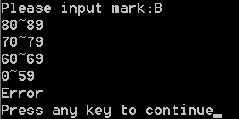
What's the output of the following code:
#include <stdio.h>
void main()
{ char mark;
printf("\nPlease input mark:");
scanf("%c",&mark); //input marks
switch(mark)
{ case 'A':printf("90~100\n");
case 'B':printf("80~89\n");
case 'C':printf("70~79\n");
case 'D':printf("60~69\n");
case 'E':printf("0~59\n");
default:printf("Error\n"); }
}

Slide 34

What's the output of the following code:
#include <stdio.h>
void main()
{ char mark;
printf("\nPlease input mark:");
scanf("%c",&mark); //input marks
switch(mark)
{ case 'A':printf("90~100\n"); break;
case 'B':printf("80~89\n");break;
case 'C':printf("70~79\n"); break;
case 'D':printf("60~69\n"); break;
case 'E':printf("0~59\n"); break;
default:printf("Error\n"); }
}

Slide 35
Nested If Statements
If statements are still statements
So they can be put in compound statements
Or they can be used inside another if statement:
if (year == 2016)
if (month == january)
rent *= 1.01;
else
if (month == january)
rent *= 1.02;
What does this do?

Slide 36
Classic Mistake No. 1
Else always pairs with the nearest if
Ignoring all indentation
In this case
else pairs with if (month == january)
only executes if month != january
the second if statement is never true
and the rent never increases by 2%

Slide 37
Solution
Always, always use compound statements
Add comment so you can see the logic
if (year == 2016)
{ // 2016
if (month == january)
{ // january, 2016
rent *= 1.01;
} // january, 2016
} // 2016
else
{ // not 2016
if (month == january)
{ // january, not 2016
rent *= 1.02;
} // january, not 2016
} // not 2016

Slide 38
Classic Mistake No. 2
year = 2017;
if (year = 2016)
printf(“2016”);
else
printf(“not 2016”);
We missed an equals sign
We used the assignment operator
Instead of the comparison operator
So we assigned 2016 to year
Then tested it (2016 is not 0, so it is true)

Slide 39
Ternary If Operator
One of the weirdest parts of C
condition ? expression1 : expression2
An operator with two symbols
And three operands
Shortcut for an if statement
but returns an assignable value

Slide 40
Sample Code
if (x>y)
max = x;
else
max = y;
With ternary operator:
max = (x>y)? x:y;
variable = condition ? expression1 : expression2
Some value to be expression 1 or expression 2

Slide 41
Examples
[ex.2]output the value of the function f (x) with an input x.

Slide 42
Examples
#include <stdio.h>
void main()
{ float x,y;
printf("\nPlease input x:");
scanf("%f",&x); //input x
if (x>=10)
y=2*x-1;
if (x>=1&&x<10) y=x*x+2*x+2;
if (x<1)
y=x;
printf("y=%f\n",y);
}

Slide 43
Examples
#include <stdio.h>
void main()
{ float x,y;
printf("\nPlease input x:");
scanf("%f",&x); //input x
if (x>=1)
if (x<10)
y=2*x-1;
else
y=x*x+2*x+2;
else
y=x;
printf("y=%f\n",y);
}

Slide 44
Exercises1
Given a function:
Write a program to accept the user input for
x, and display the value of y
f(x)=
2x x<10
3x-10 10 <=x<20
5x-100 x>=20

Slide 45
Exercises 2
企业放发的奖金根据利润提成。设企业的利润为I，提成标准如下：
I＜10万元时，提成10%;
10万元＜I≤20万元时,低于10万元部分仍按10％提成，高于10万元部分按7.5％提成；
20万元＜I≤40万元时,低于20万元部分按前面方法提成，高于20万元部分按5％提成；
40万元＜I≤60万元时,低于40万元部分按前面方法提成，高于40万元部分按3％提成；
60万元＜I≤100万元时,低于60万部分按前面方法提成，高于60万部分按1.5％提成；
100万元＜I时，低于100万元部分按前面方法提成，高于100万元部分按1％提成。
编程输入利润I，计算输出提成金额。

